Slide 1
Information Retrieval:
Foundation to Web Search
Zachary G. Ives
University of Pennsylvania
CIS 455 / 555 – Internet and Web Systems
November 7, 2026
Some slides by Berthier Ribeiro-Neto

Slide 2
Reminders & Announcements
Midterm on 3/31, 80 minutes, closed-book
  Past midterms will be available on the web site

Slide 3
Web Search
Goal is to find information relevant to a user’s interests
Challenge 1: A significant amount of content on the web is not quality information
  Many pages contain nonsensical rants, etc.
  The web is full of misspellings, multiple languages, etc.
  Many pages are designed not to convey information – but to get a high ranking (e.g., “search engine optimization”)
Challenge 2: billions of documents
Challenge 3: hyperlinks encode information

Slide 4
Our Discussion of Web Search
Begin with traditional information retrieval
  Document models
  Stemming and stop words
Web-specific issues
  Crawlers and robots.txt
  Scalability
  Models for exploiting hyperlinks in ranking
    Google and PageRank
    Latent Semantic Indexing

Slide 5
Information Retrieval
Traditional information retrieval is basically text search
  A corpus or body of text documents, e.g., in a document collection in a library or on a CD
  Documents are generally high-quality and designed to convey information
  Documents are assumed to have no structure beyond words
Searches are generally based on meaningful phrases, perhaps including predicates over categories, dates, etc.
The goal is to find the document(s) that best match the search phrase, according to a search model
Assumptions are typically different from Web: quality text, limited-size corpus, no hyperlinks

Slide 6
Motivation for Information Retrieval
Information Retrieval (IR) is about:
  Representation
  Storage
  Organization of
  And access to “information items”
Focus is on user’s “information need” rather than a precise query:
  “March Madness” – Find information on college basketball teams which: (1) are maintained by a US university and (2) participate in the NCAA tournament
Emphasis is on the retrieval of information (not data)

Slide 7
Data vs. Information Retrieval
Data retrieval, analogous to database querying: which docs contain a set of keywords?
  Well-defined, precise logical semantics
  A single erroneous object implies failure!
Information retrieval:
  Information about a subject or topic
  Semantics is frequently loose; we want approximate matches
  Small errors are tolerated (and in fact inevitable)
IR system:
  Interpret contents of information items
  Generate a ranking which reflects relevance
  Notion of relevance is most important – needs a model

Slide 8

Basic Model
Docs
Index Terms
doc
match
Information Need
Ranking
?
query

Slide 9
Information Retrieval as a Field
IR addressed many issues in the last 20 years:
  Classification and categorization of documents
  Systems and languages for searching
  User interfaces and visualization of results
Area was seen as of narrow interest – libraries, mainly
Sea-change event – the advent of the web:
  Universal “library”
  Free (low cost) universal access
  No central editorial board
  Many problems in finding information:
  IR seen as key to finding the solutions!

Slide 10
The Full Info Retrieval Process
Browser / UI
Text
user interest
Text
Text Processing and Modeling
logical view
logical view
Query
Operations
Indexing
user feedback
Crawler
/ Data
Access
query
inverted index
Searching
Index
retrieved docs
Documents (Web or DB)
Ranking
ranked docs

Slide 11
Terminology
IR systems usually adopt index terms to process queries
Index term:
  a keyword or group of selected words
  any word (more general)
Stemming might be used:
  connect: connecting, connection, connections
An inverted index is built for the chosen index terms

Slide 12
What’s a Meaningful Result?
Matching at index term level is quite imprecise
  Users are frequently dissatisfied
  One problem: users are generally poor at posing queries
  Frequent dissatisfaction of Web users (who often give single-keyword queries)
Issue of deciding relevance is critical for IR systems: ranking

Slide 13
Rankings
A ranking is an ordering of the documents retrieved that (hopefully) reflects the relevance of the documents to the user query
A ranking is based on fundamental premises regarding the notion of relevance, such as:
  common sets of index terms
  sharing of weighted terms
  likelihood of relevance
Each set of premisses leads to a distinct IR model

Slide 14
Types of IR Models
Set Theoretic
Fuzzy
Extended Boolean
Classic Models
boolean
vector
probabilistic
Algebraic
U
s
e
r
T
a
s
k
Generalized Vector
Lat. Semantic Index
Neural Networks
Retrieval:
Adhoc
Filtering
Structured Models
Probabilistic
Non-Overlapping Lists
Proximal Nodes
Inference Network
Belief Network
Browsing
Browsing
Flat
Structure Guided
Hypertext

Slide 15
Classic IR Models – Basic Concepts
Each document represented by a set of representative keywords or index terms
An index term is a document word useful for remembering the document main themes
Traditionally, index terms were nouns because nouns have meaning by themselves
However, search engines assume that all words are index terms (full text representation)

Slide 16
Classic IR Models – Ranking
Not all terms are equally useful for representing the document contents: less frequent terms allow identifying a narrower set of documents
The importance of the index terms is represented by weights associated to them
Let
  k_{i} be an index term
  d_{j} be a document
  w_{ij} is a weight associated with (k_{i},d_{j})
The weight w_{ij} quantifies the importance of the index term for describing the document contents

Slide 17
Classic IR Models – Notation
k_{i} is an index term (keyword)
d_{j} is a document
t is the total number of docs
K = (k₁, k₂, …, k_{t}) is the set of all index terms
w_{ij} >= 0 is a weight associated with (k_{i},d_{j})
w_{ij} = 0 indicates that term does not belong to doc
vec(d_{j}) = (w_{1j}, w_{2j}, …, w_{tj}) is a weighted vector associated
with the document d_{j}
g_{i}(vec(d_{j})) = w_{ij} is a function which returns the weight
associated with pair (k_{i},d_{j})

Slide 18
Boolean Model
Simple model based on set theory
Queries specified as boolean expressions
  precise semantics
  neat formalism
  q = k_{a} ∧ (k_{b} ∨ ¬k_{c})
Terms are either present or absent. Thus,
w_{ij} ∈ {0,1}
An example query
  q = k_{a} ∧ (k_{b} ∨ ¬k_{c})
  Disjunctive normal form: vec(q_{dnf}) = (1,1,1) ∨ (1,1,0) ∨ (1,0,0)
  Conjunctive component: vec(q_{cc}) = (1,1,0)

Slide 19
Boolean Model for Similarity
K_{a}
K_{b}
q = k_{a} ∧ (k_{b} ∨ ¬k_{c})
sim(q,dj) = 1 if ∃ vec(qcc) s.t. (vec(qcc) ∈ vec(qdnf)) ∧ (∀k_{i}, g_{i}(vec(d_{j})) = g_{i}(vec(qcc))) 0 otherwise
(1,1,0)
(1,0,0)
(1,1,1)
{
K_{c}

Slide 20
Drawbacks of Boolean Model
Retrieval based on binary decision criteria with no notion of partial matching
No ranking of the documents is provided (absence of a grading scale)
Information need has to be translated into a Boolean expression which most users find awkward
The Boolean queries formulated by the users are most often too simplistic
As a consequence, the Boolean model frequently returns either too few or too many documents in response to a user query

Slide 21
Vector Model
A refinement of the boolean model, which focused strictly on exact matchines
  Non-binary weights provide consideration for partial matches
  These term weights are used to compute a degree of similarity between a query and each document
Ranked set of documents provides for better matching

Slide 22
Vector Model
Define:
  w_{ij} > 0 whenever k_{i} ∈ d_{j}
  w_{iq} >= 0 associated with the pair (k_{i},q)
  vec(d_{j}) = (w_{1j}, w_{2j}, ..., w_{tj})
  vec(q) = (w_{1q}, w_{2q}, ..., w_{tq})
  With each term k_{i} , associate a unit vector vec(i)
  The unit vectors vec(i) and vec(j) are assumed to be orthonormal (i.e., index terms are assumed to occur independently within the documents)
The t unit vectors vec(i) form an orthonormal basis for a t-dimensional space
In this space, queries and documents are represented as weighted vectors

Slide 23
Vector Model
j
dj
Θ
Sim(q,d_{j}) = cos(Θ)
= [vec(d_{j}) • vec(q)] / |d_{j}| * |q|
= [Σ w_{ij} * w_{iq}] / |d_{j}| * |q|
Since w_{ij} > 0 and w_{iq} > 0,
0 ≤ sim(q,d_{j}) ≤ 1
A document is retrieved even if it matches the query terms only partially
q
i

Slide 24
Weights in the Vector Model
Sim(q,d_{j}) = [Σ w_{ij} * w_{iq}] / |d_{j}| * |q|
How do we compute the weights w_{ij} and w_{iq}?
A good weight must take into account two effects:
  quantification of intra-document contents (similarity)
    tf factor, the term frequency within a document
  quantification of inter-documents separation
  (dissimilarity)
    idf factor, the inverse document frequency
  w_{ij} = tf(i,j) * idf(i)

Slide 25
TF and IDF Factors
Let:
  N be the total number of docs in the collection
  n_{i} be the number of docs which contain k_{i}
  freq(i,j) raw frequency of k_{i} within d_{j}
A normalized tf factor is given by
  f(i,j) = freq(i,j) / max(freq(l,j))
  where the maximum is computed over all terms which occur within the document d_{j}
The idf factor is computed as
  idf(i) = log (N / n_{i})
  the log is used to make the values of tf and idf comparable.
  It can also be interpreted as the amount of information associated with the term k_{i}

Slide 26
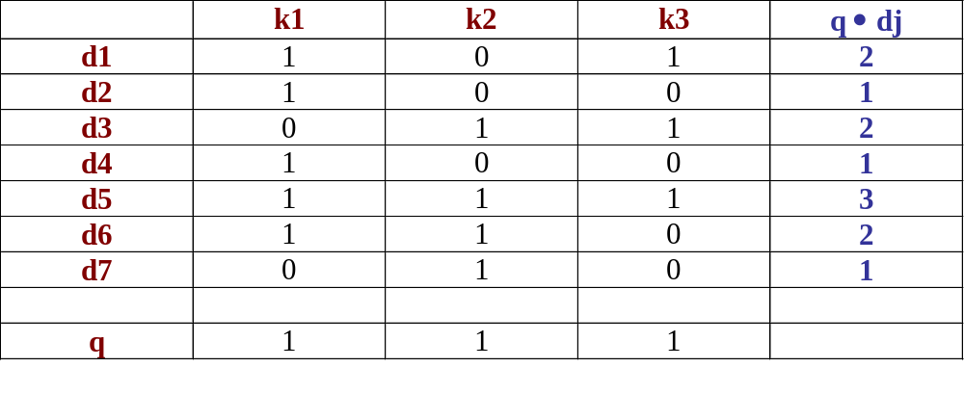
Vector Model
Example 1
k2
k1
d7
d2
d6
d4
d5
d3
d1
k3

Slide 27
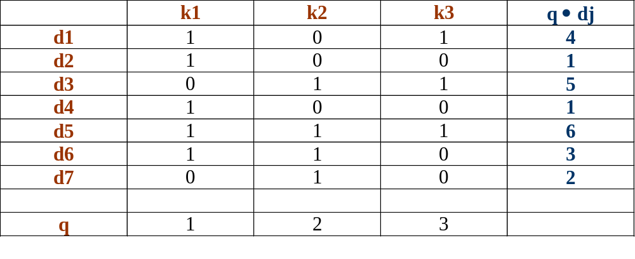
Vector Model
Example 1I
k2
k1
d7
d2
d6
d4
d5
d3
d1
k3

Slide 28
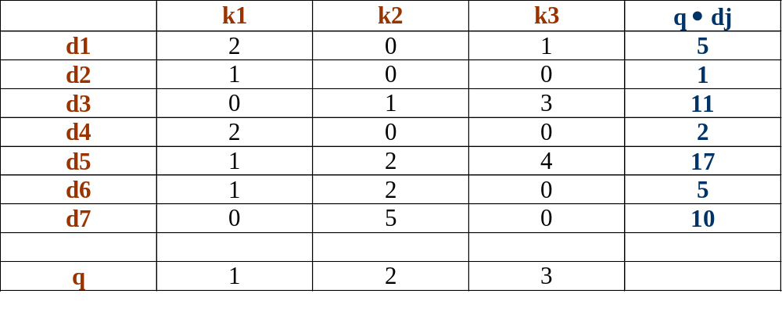
Vector Model
Example III
k2
k1
d7
d2
d6
d4
d5
d3
d1
k3

Slide 29
Vector Model, Summarized
The best term-weighting schemes tf-idf weights:
  w_{ij} = f(i,j) * log(N/n_{i})
For the query term weights, a suggestion is
  w_{iq} = (0.5 + [0.5 * freq(i,q) / max(freq(l,q)]) * log(N / n_{i})
This model is very good in practice:
  tf-idf works well with general collections
  Simple and fast to compute
  Vector model is usually as good as the known ranking alternatives

Slide 30
Pros & Cons of Vector Model
Advantages:
  term-weighting improves quality of the answer set
  partial matching allows retrieval of docs that approximate the query conditions
  cosine ranking formula sorts documents according to degree of similarity to the query
Disadvantages:
  assumes independence of index terms; not clear if this is a good or bad assumption

Slide 31
Comparison of Classic Models
Boolean model does not provide for partial matches and is considered to be the weakest classic model
Some experiments indicate that the vector model outperforms the third alternative, the probabilistic model, in general
  Recent IR research has focused on improving probabilistic models – but these haven’t made their way to Web search
Generally we use a variation of the vector model in most text search systems

Slide 32
Next Time: The Web
… And in particular, PageRank!

